Slide 1
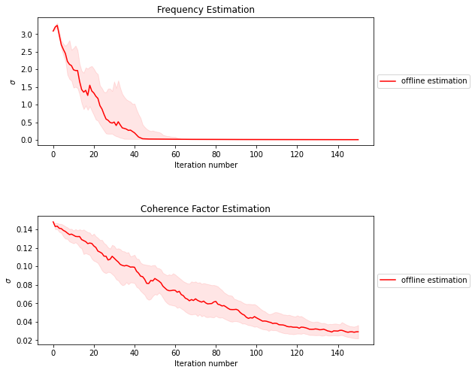

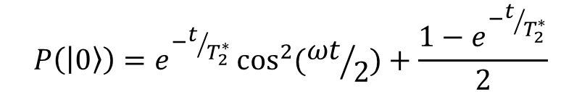
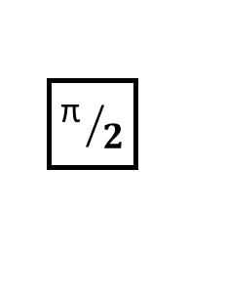
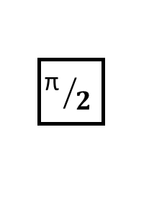
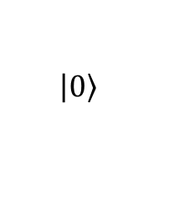


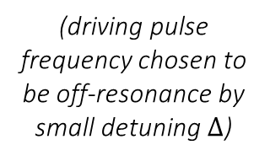
Ramsey experiment on IBMQ device ‘Guadalupe’
(3 Markov moves)
$$\left.\left|0\right.\right\rangle$$
$${\text{π} }/2$$
$${\text{π} }/2$$
$$∆t$$
(driving pulse frequency chosen to be off-resonance by small detuning $∆$)
$$∆$$
$$P\left(\left.\left|0\right.\right\rangle \right)=e^{−t/{T_{2}^{∗}}}\cos^{2}{({ωt}/2)}+\frac{1−e^{−t/{T_{2}^{∗}}}}{2}$$
(All graphs use sequential importance resampling SMC with ${15}^{2}$ particles for 2d inference or $50$ particles for 1d, 1 datum added per step, gaussian random walk Metropolis for resampling, and a single Markov move per particle per resampler call unless otherwise stated, and take the median results over 100 runs uniformly distributed by 10 datasets collected from IBMQ’s backends using OpenPulse.)

Slide 2
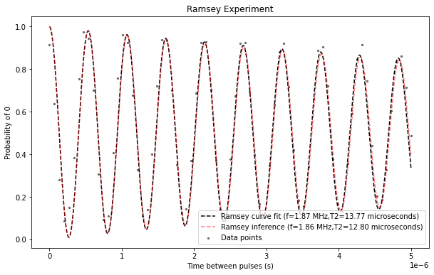
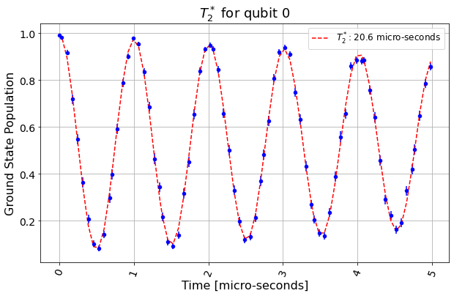

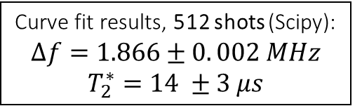
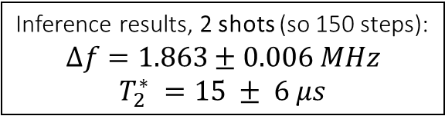
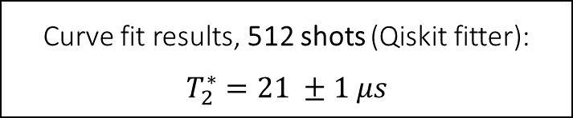
Ramsey experiment on IBMQ device ‘Guadalupe’ – inference vs. curve fitting
Curve fit results, 512 shots (Scipy):
$$∆f=1.866±0. 002 MHz$$
$$T_{2}^{∗}=14 ±3 μs$$
Inference results, 2 shots (so 150 steps):
$$∆f=1.863±0.006 MHz$$
$$T_{2}^{∗} =15 ± 6 μs$$
Curve fit results, 512 shots (Qiskit fitter):
$$T_{2}^{∗}=21 ±1 μs$$
(3 Markov moves)
$∆f≈1.83$ (apart from errors in the backend resonance frequency estimate)
Same set of measurements for both; 75 evenly spaced times for t ∈ [0.2,5[ μs
nosc = 5, $∆f=0.99 MHz$

Slide 3
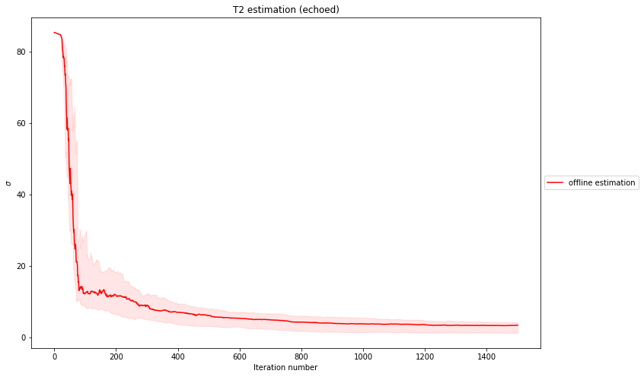
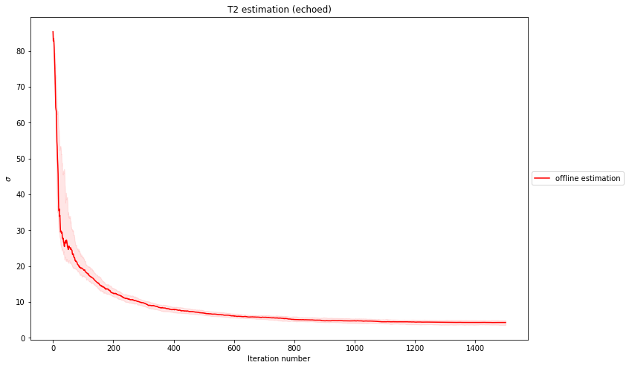
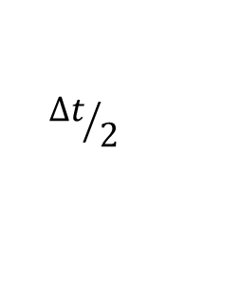
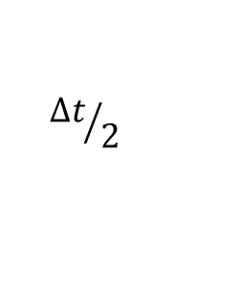


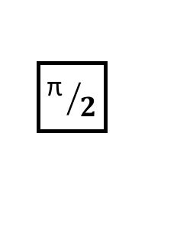
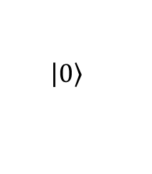
Hahn echo experiment on IBMQ device ‘Rome’
$$\left.\left|0\right.\right\rangle$$
$${\text{π} }/2$$
π
$${\text{π} }/2$$
$P\left(\left.\left|0\right.\right\rangle \right)=\frac{1}{2}e^{−t/{T_{2}}}$ + $\frac{1}{2}$
$${∆t}/2$$
$${∆t}/2$$
Benefits from measurements being fed to the sampler by reversed order of time evolution (R), oppositely to by increasing order (L) as in Ramsey-type experiments, probably due to having steeper slopes close to origin. This order yields more reliable estimation, less resampler calls, and a higher acceptance rate
Different learning pace from sinusoidal likelihood → requires more data (here 1500), but less resampling steps (here 1%)

Slide 4
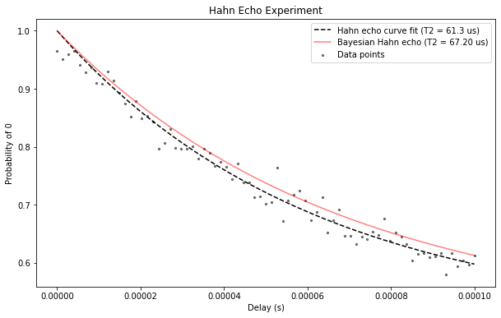
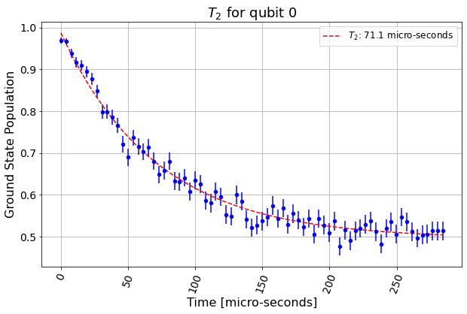
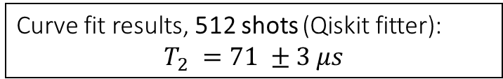
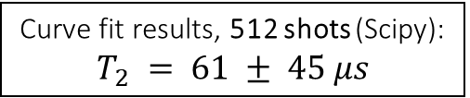
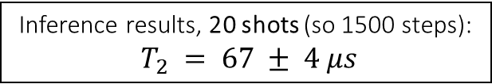
Hahn echo experiment on IBMQ device ‘Rome’ – inference vs. curve fitting
fixed coordinate
allows for offset in both factor and exponent
Curve fit results, 512 shots (Scipy):
$$T_{2} = 61 ± 45 μs$$
Inference results, 20 shots (so 1500 steps):
$T_{2} = 67 ± 4 μs$
Curve fit results, 512 shots (Qiskit fitter):
$$T_{2} =71 ±3 μs$$
Same set of 75 evenly spaced measurement times for both
(t ∈ [0.2,100[ μs)
(Scipy curve fitter is also used internally for the estimate, but the uncertainty is instead calculated from the variance of the success probability which seems to provide a more reasonable estimate)
─ Estimated backend $T_{2} =77$ $μs$ (not too reliable between calibrations)

Slide 5
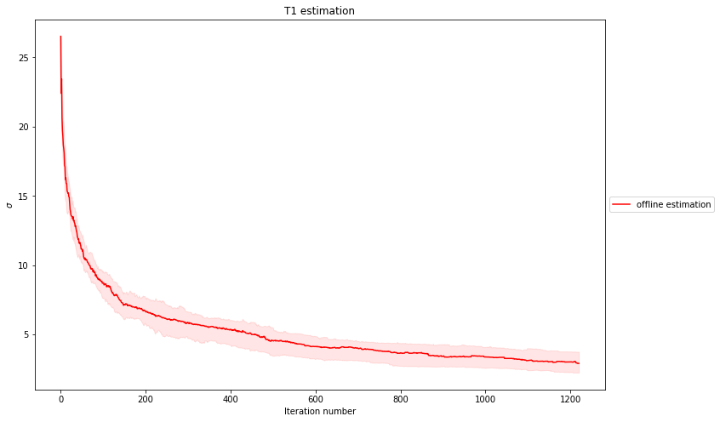

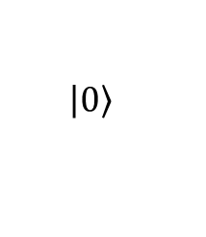
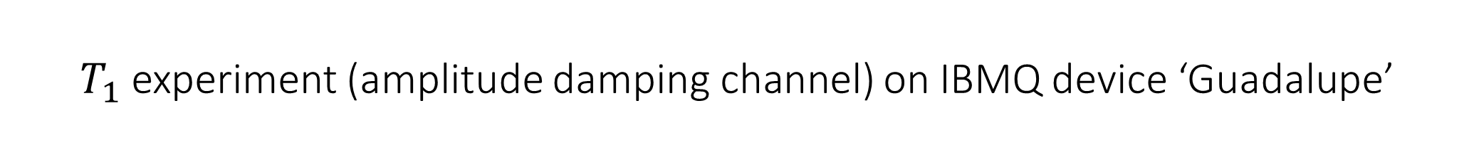



$T_{1}$ experiment (amplitude damping channel) on IBMQ device ‘Guadalupe’
$$\left.\left|0\right.\right\rangle$$
$$\text{π}$$
$$∆t$$
$$P\left(\left.\left|1\right.\right\rangle \right)=e^{−t/{T_{1}}}$$
Similar to $T_{1}$ (same class of models)

Slide 6
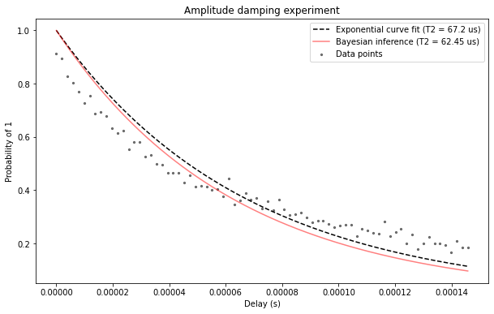
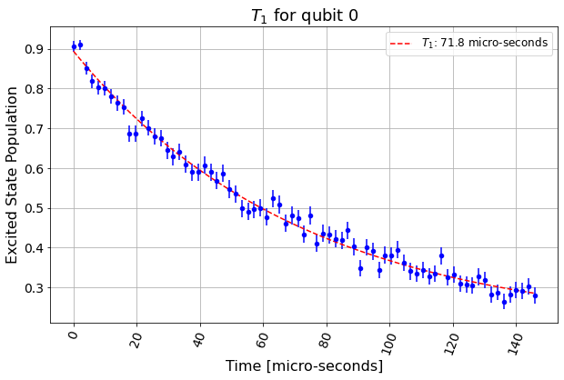
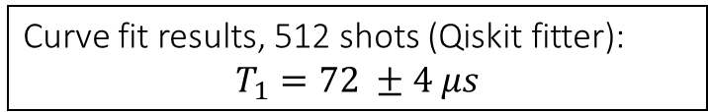
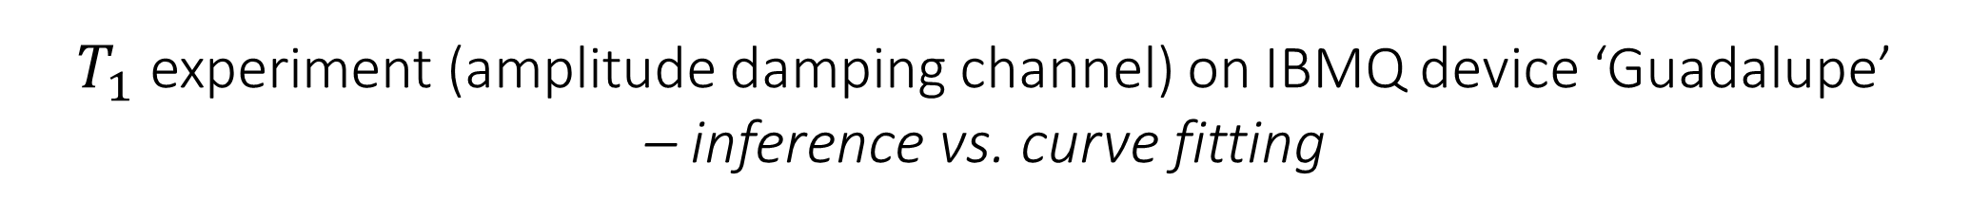
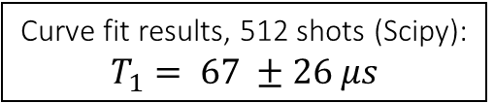
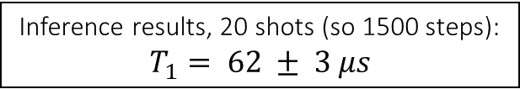
$T_{1}$ experiment (amplitude damping channel) on IBMQ device ‘Guadalupe’ – inference vs. curve fitting
fixed coordinate
Curve fit results, 512 shots (Scipy):
$$T_{1}= 67 ±26 μs$$
Inference results, 20 shots (so 1500 steps):
$$T_{1}= 62 ± 3 μs$$
Curve fit results, 512 shots (Qiskit fitter):
$$T_{1}=72 ±4 μs$$
─ Estimated backend $T_{1} =49$ $μs$ (not too reliable between calibrations)

Slide 7
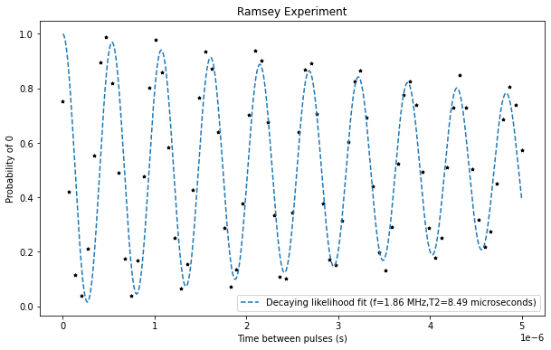
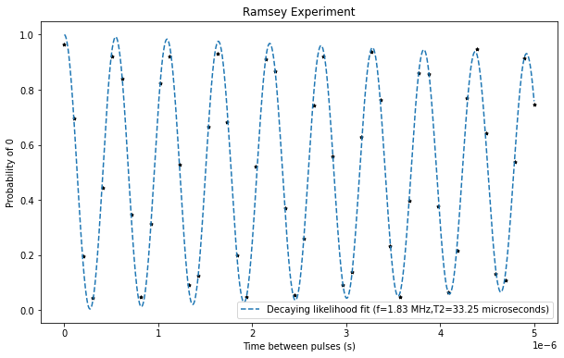

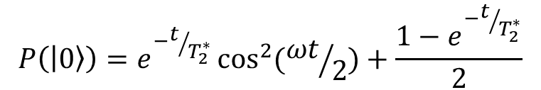
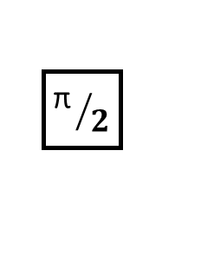



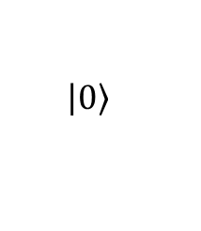
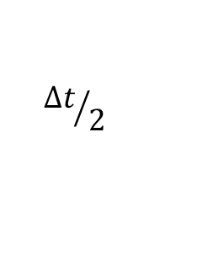
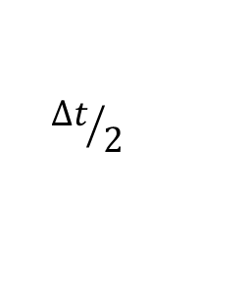

Echoed Ramsey experiment on IBMQ device ‘Armonk’
$$\left.\left|0\right.\right\rangle$$
$${\text{π} }/2$$
π
$${\text{π} }/2$$
$$P\left(\left.\left|0\right.\right\rangle \right)=e^{−t/{T_{2}^{∗}}}\cos^{2}{({ωt}/2)}+\frac{1−e^{−t/{T_{2}^{∗}}}}{2}$$
$${∆t}/2$$
$${∆t}/2$$
(for a larger $T_{2}^{∗}$, which can be considered $+∞$ for short evolution times; allows for testing approximate 1d estimation in the previous timeframe)
$$∆$$
$$−∆$$
$$∆$$
Vitanov et. al, Fault-tolerant Hahn-Ramsey interferometry with pulse sequences of alternating detuning

Slide 8
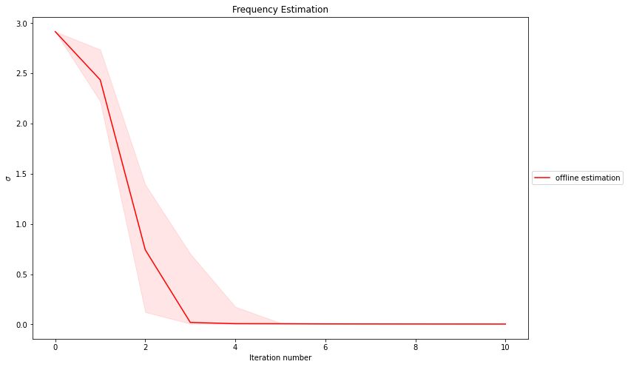
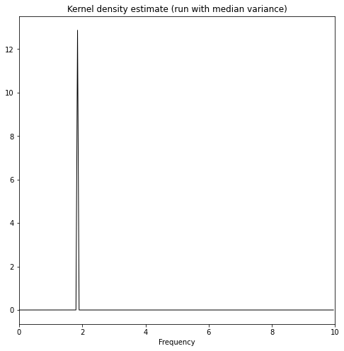
Echoed Ramsey experiment on IBMQ device ‘Armonk’ – tempered likelihood estimation (1d)
HMC
Parallel Markov chains are inefficient for long evolution times and/or wide priors (too steep likelihood function causes trajectory divergence for HMC, low acceptance for RWM)
If taking a non-sequential approach, coupling particles and tempering the likelihoods works better and allows for scale-independent calculations of the Bayes’ factors, while being more suitable to assymptotically correct subsampling schemes

Slide 9
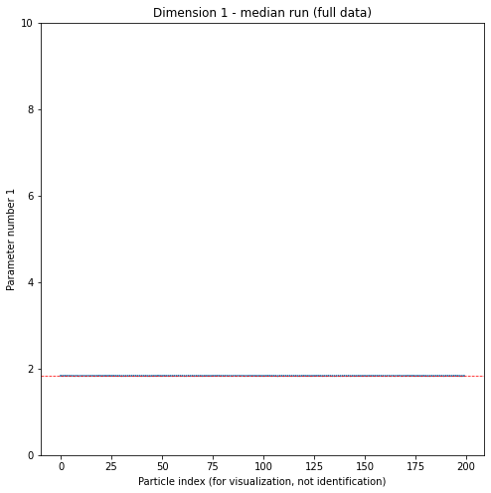
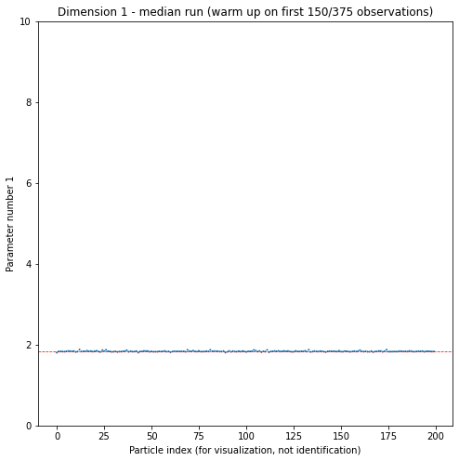
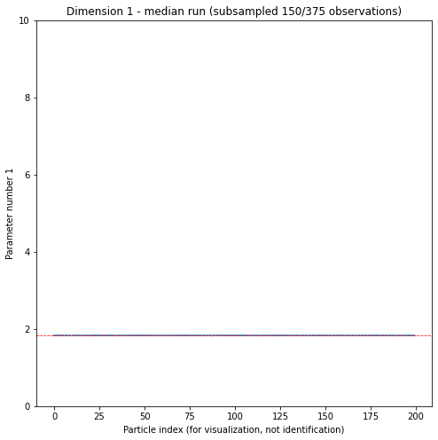
Echoed Ramsey experiment on IBMQ device ‘Armonk’ – subsampling with control variates and a warm-up phase
Full data
Subsampling (150/375 observations with a warm-up)
Gradient-based control variates (Taylor expansions) don’t work well due to high target curvature, which can be controlled by either keeping the evolution times short (inefficient because they bring little information after a point) or narrowing the prior. The latter can be done by a warm-up phase on the first (lower times) observations if prior knowledge is insufficient to justify it (the prior may be flattened before proceeding if the marginal likelihoods are required)

Slide 10
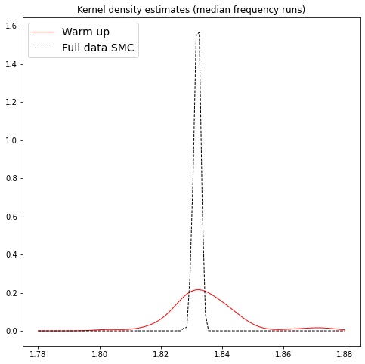
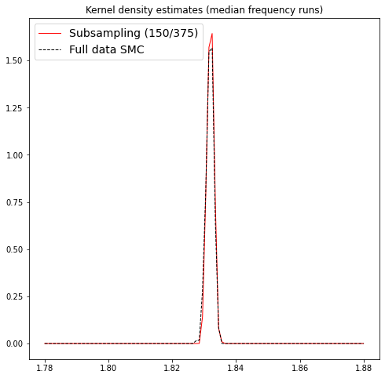

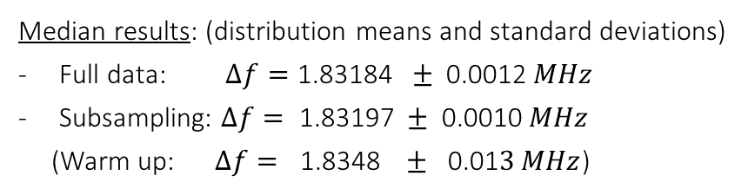
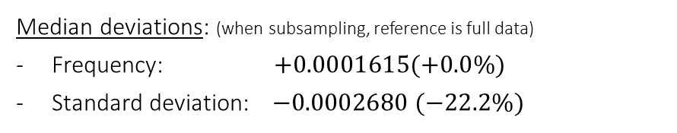
Echoed Ramsey experiment on IBMQ device ‘Armonk’ – subsampling with control variates and a warm-up phase
$∆f≈1.83 MHz$
200 particles;
prior on f ∈ [0,10[
Median results: (distribution means and standard deviations)
Full data: $∆f=\text{1.8318}\text{4} ± \text{0.0012} MHz$
Subsampling: $∆f= \text{1.8319}\text{7} ± \text{0.00}\text{10} MHz$
(Warm up: $∆f= \text{1.8348 } ± \text{0.01}3 MHz$)
Median deviations: (when subsampling, reference is full data)
Frequency: $\text{+}\text{0.000161}\text{5}\text{(+0.0\%)}$
Standard deviation: $−0.0002680 (−22.2\%)$

Slide 11
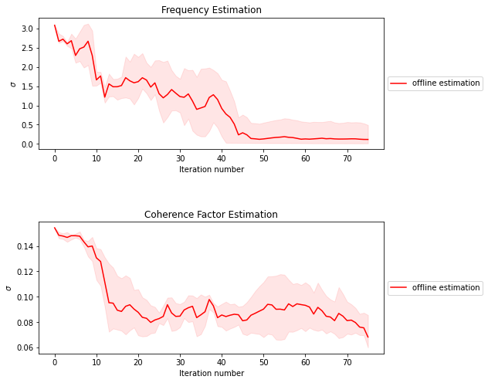
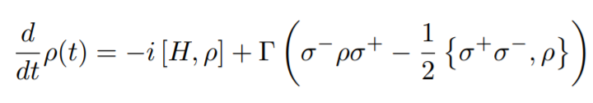

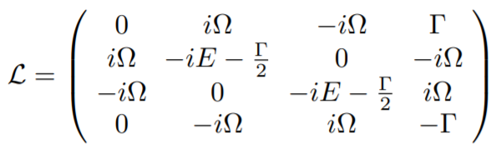

Ramsey experiment on IBMQ device ‘Armonk’ - inference with Liouvillian integration based likelihoods
$$∆f=1.85 ±0. 1 MHz$$
$$T_{2}^{∗}=3.3 ±0.8 μs$$
«Statistics» over 3 runs and with all but latest 30 data dropped when resampling (integration takes very long)
Daniel Manzano, A short introduction to the Lindblad Master Equation

Slide 12


Ramsey experiment on IBMQ device ‘Armonk’ - curve fitting with Liouvillian integration based likelihoods
Master equation time evolution (L) vs. the damped oscillator model (R) given the same data (black markers)

Slide 13






Integration methods for simulating the time evolution
RK2
RK4
Integrator results for P(1):
Runge-Kutta 2(3): 0.8495685717649359+0j
Runge-Kutta 4(5): 0.8578922098165880+0j
Runge-Kutta 8: 0.8565401440306653+0j
Backward diff: 0.8567935084404129+0j
High precision RK8*: 0.8571408221863202+0j
RK8
BDF
*Reference
Time taken (same tolerances except for last):
Runge-Kutta 2(3): 13.9 ms
Runge-Kutta 4(5): 5.0 ms
Runge-Kutta 8: 6.8 ms
Backward diff: 36.3 ms
High precision RK8: 20.5 ms
RK8
(higher precision)
Plotting only the computed points
Dashed line gives $ρ_{11}$ for the damped oscillator model
E ≈ 0

